Slide 1
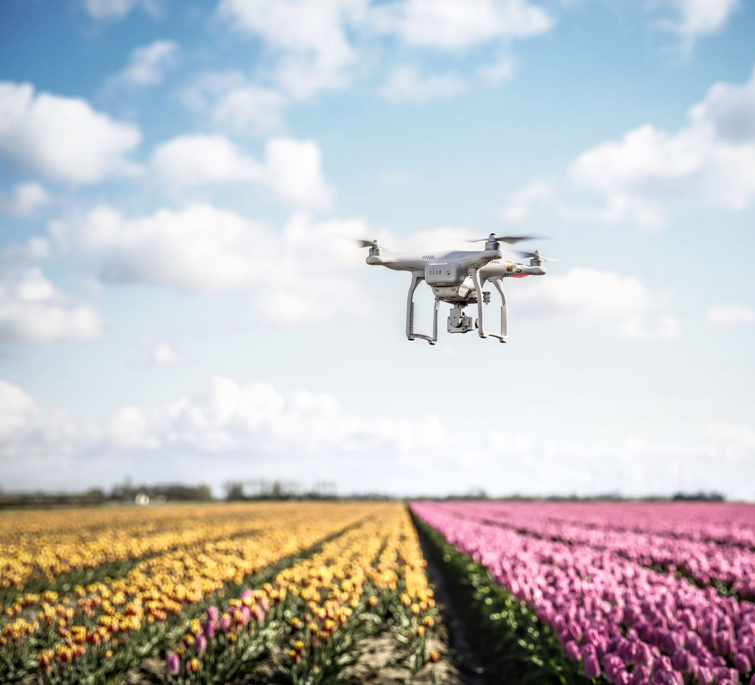
Camera for Agricultural Drone Presentation By: MANISH SONI

Slide 2
A Little Background about agricultural drones
Drones are increasingly becoming helpful in agricultural operations, to increase crop production in precision agriculture.
Crop Spraying and Spot Spraying
Seed planting
Soil Analysis
Monitoring crop Growth
We want to use a camera setup over a drone to help monitor the farm. It may help us in better Crop yields and farm efficiency because of detection of irrigation problem, soil variation, pest and fungal infestation.

Slide 3
Problem statement
We want to use a camera setup over a drone to help monitor the farm. It may help us in better Crop yields and farm efficiency because of detection of irrigation problem, soil variation, pest and fungal infestation

Slide 4
objective
Objective of this problem is to use multispectral images captured by drones to measure NDVI and other form of different analysis indexes such as NDRE to provide us with the crop growth analysis so to take corrective measures.

Slide 5
Various types of agri mapping technique
1. Chlorophyll Map: The red edge spectral band is the star here, working in conjunction with the other bands to provide a more accurate measure of not just plant vigor but plant health.
2. NDVI Layer: This commonly known index compares the reflectance of the red band with that of the near-infrared band. However, this index alone provides limited information.
3. Digital Surface Model: A DSM is an astonishingly advantageous tool in any agronomist’s arsenal, primarily because of its use in evaluating surface properties and water flow.
4. RGB Image: RedEdge-MX features global shutters for distortion-free images, including narrowband red, green, and blue bands for RGB color images that when processed are aligned to all visible and non-visible bands and vegetation indices.

Slide 6
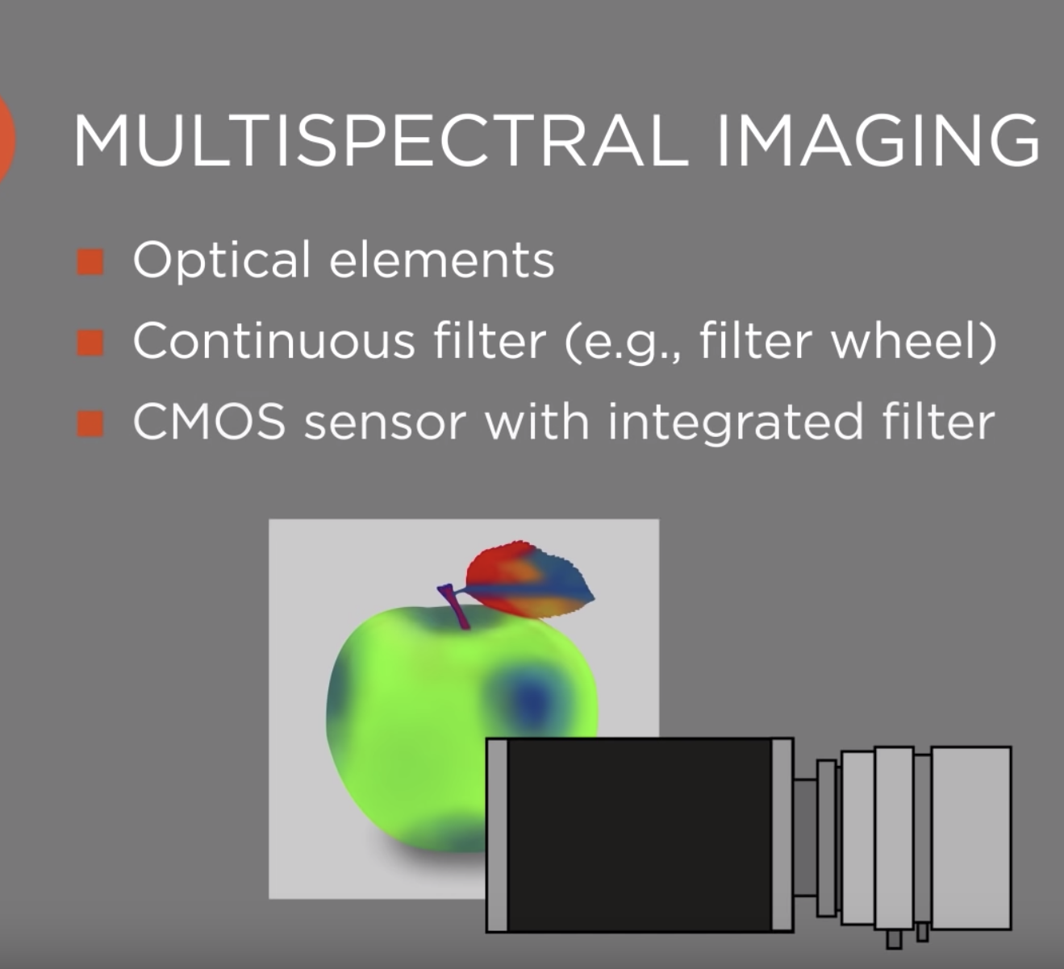
Multispectral images and image sensors
Multispectral imaging means methods for spectral imaging where one obtains images corresponding to at least a couple of spectral channels. The used spectral regions are often at least partially outside the visible spectral range, covering parts of the infrared and ultraviolet region.

Slide 7
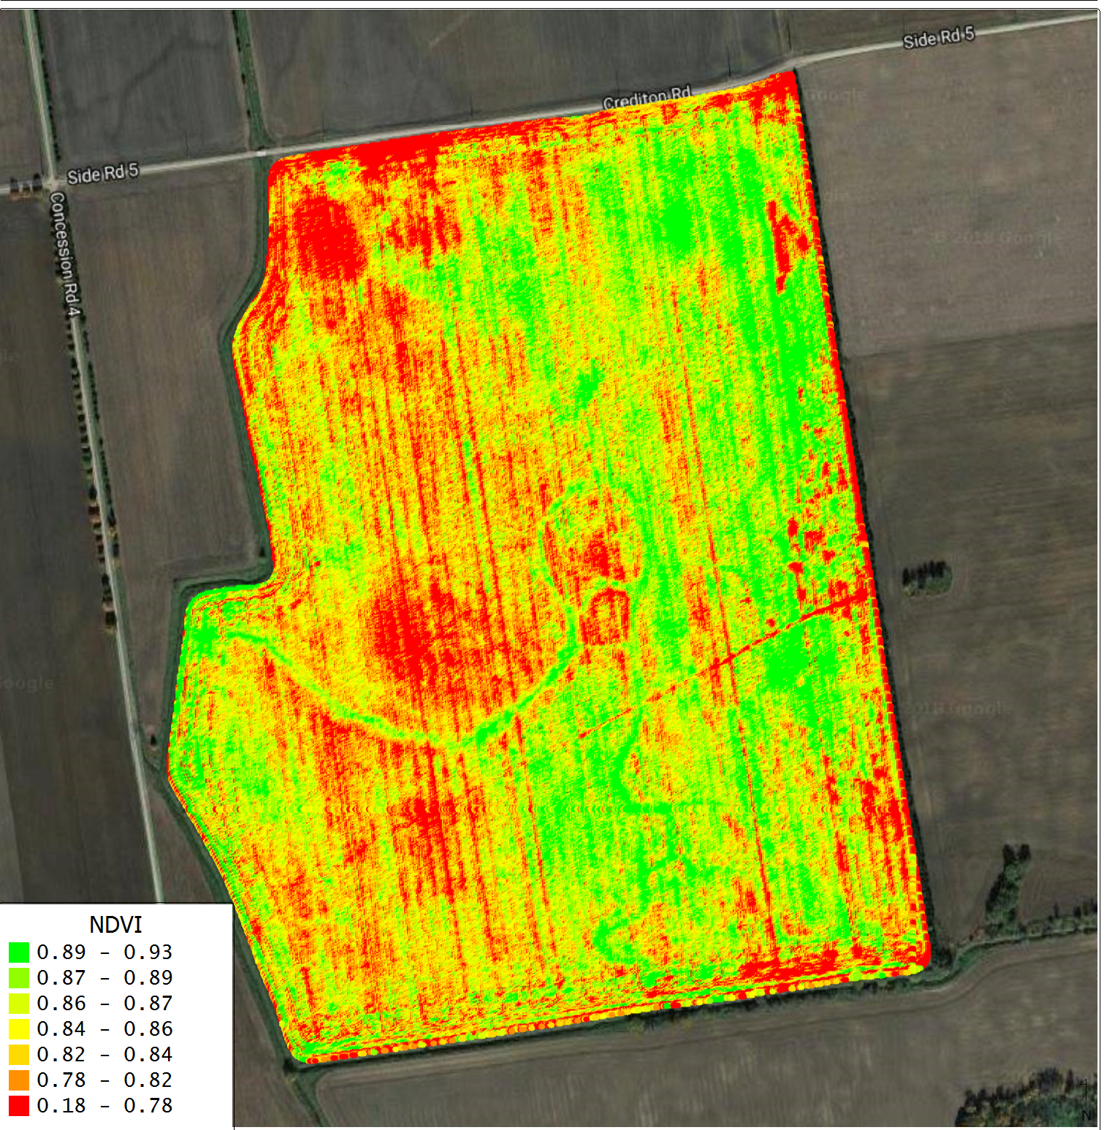
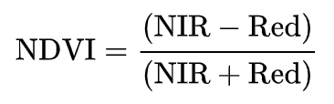
NDVI: Normalized difference vegetation index
Normalized difference vegetation index
NDVI is calculated from the red and near-infrared
(band 1 and band 2) reflectances as
NDVI Value Range -1.0 to +1.0
-0.1 - +0.1 for mountains and barren land
+0.6-+0.8 for dense vegetation
-1.0 corresponds to Water

Slide 8
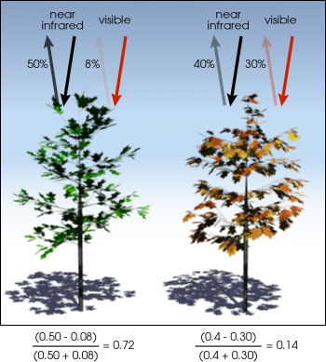
NDVI
Healthy vegetation (chlorophyll) reflects more near-infrared (NIR) and green light compared to other wavelengths. But it absorbs more red and blue light.

Slide 9
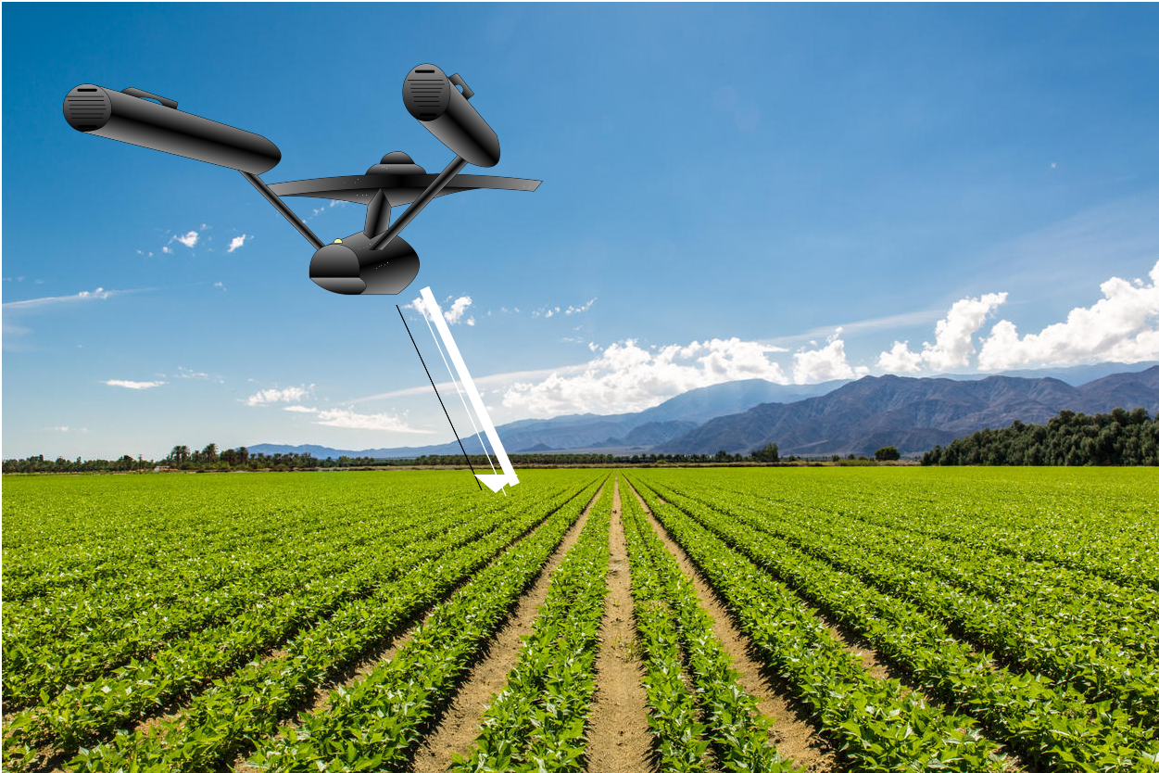
Setup

Slide 10
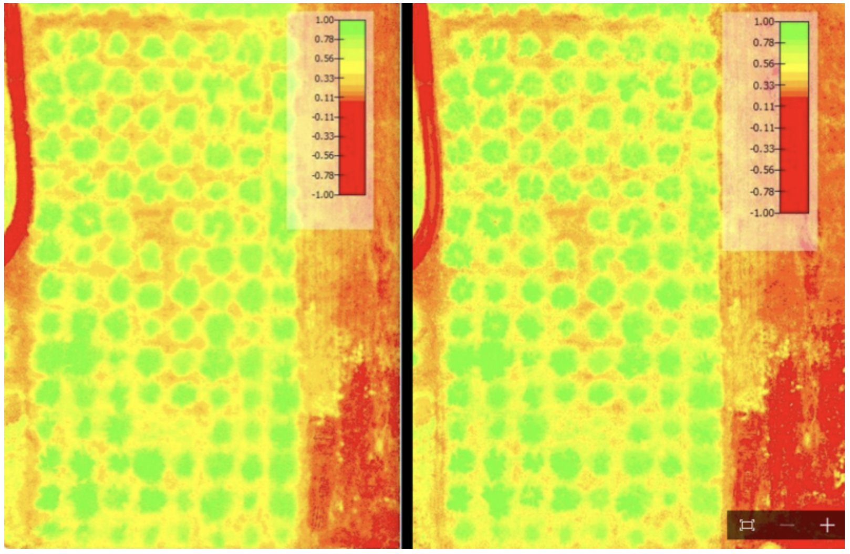
Motivation: Difference between Micasense RedEdge 3 (7000 usd)(8 cm per pixel (per band) at 120 m (~400 ft) AGL) 47.2 Hov vs Canon S100 + Midopt filter (200 usd)

Slide 11
Main camera requirement
Our typical camera would look like:
Light weight.
Should consume low power.
Should have good resolution and should work in far range.
Ideal operation height is 60 meters. (Maximum allowed height is 400 ft/120 meters by DoT)
Should have around 1 cm or 2 cm / pixel resolution on ideal operational height.
Should be able to capture multispectral images.
High FPS.

Slide 12
Main camera design
Sensor Spec:
SONY Exmor IMX377: https://www.sony-semicon.co.jp/products/common/pdf/IMX377CQT_Flyer.pdf
4152*3062 pixels == 12.71 M pixels [Diagonal : 7.81 mm type 1/ 2.3” ]
Top level lens spec for our application:
Focal length= 5.5 mm
Camera spec:
Pixel pitch= 1.55 microns Number of detectors: 4152 *3062 (W*L) Dimension of detectors: 6.435 mm x 4.746 mm
FOV:
Horizontal fov= 6.435/5.5mm = 50 degree
Vertical fov= 4.746/5.5 = 40 degree
Angular per pixel = 1.55/5.5= 0.28 mRad Pixel size over 60 m= ((1.55 * e-6)*60)/5.5 mm= 1.69 cm/pixel

Slide 13
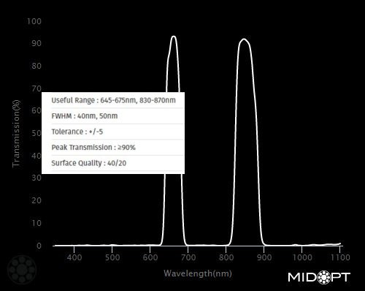
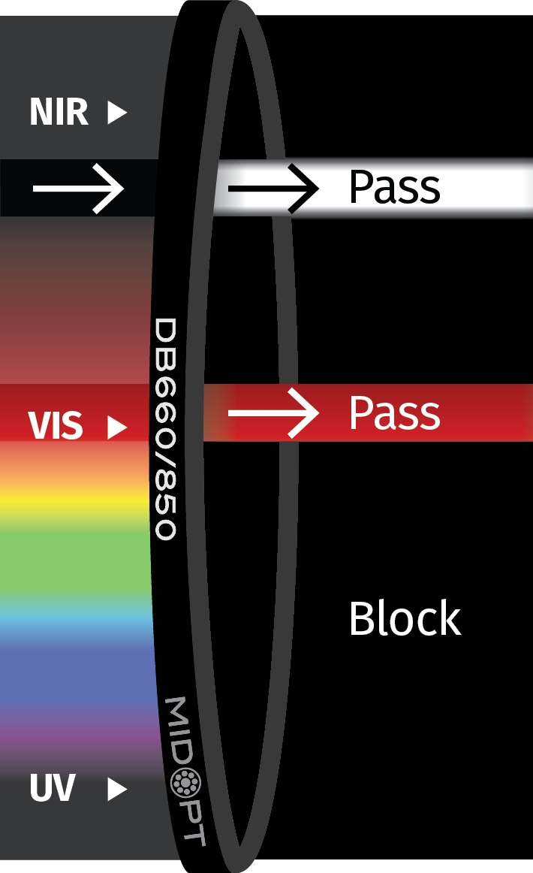
MidOpt DB 660/850 filter (Useful Range : 645-675nm, 830-870nm) reflected red light (660nm) infrared light (850nm)

Slide 14
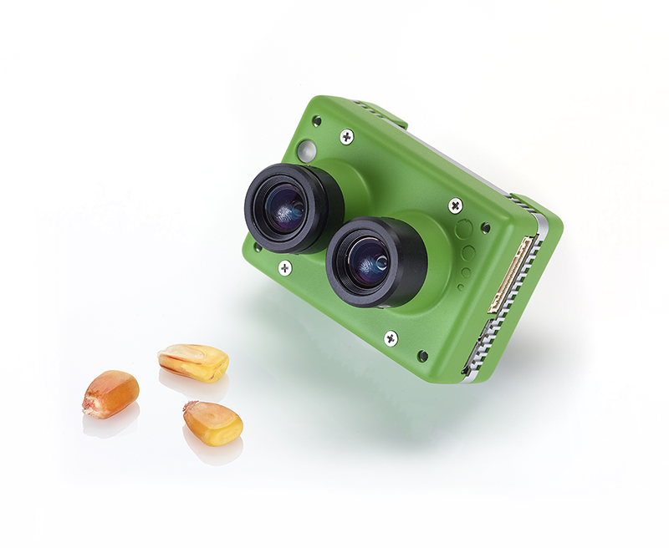
Commercial options
Sentera Double 4k
Sensors 12.3MP BSI CMOS • Sony Exmor R™ IMX377
Sensor Spectral bands
NDVI • Red: 625nm x 100nm width • NIR: 850nm x 40nm width
NDRE • Red Edge: 720nm x 40nm width • NIR 840nm x 20nm width
Data capture 12.3MP Stills 4K Ultra HD video @ 30fps 1080p/720p Video • H.264 encoding
Field of view: 60° HFOV (4K Stills / Video) 1080p ranges 30° - 60° HFOV

Slide 15
Conclusion
As we have seen above, we wanted to have a camera for our agricultural analysis setup, and we tried to set our specification and have found reliable sensor and lens for the application.

Slide 16
reference
https://www.micasense.com/rededge-mx
https://www.sony-semicon.co.jp/products/common/pdf/IMX377CQT_Flyer.pdf
https://publiclab.org/notes/Claytonb/07-09-2016/plant-health-ndvi-consumer-camera-vs-professional-multispectral-camera

